Slide 1


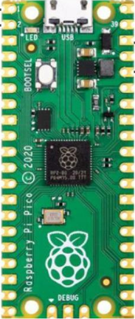
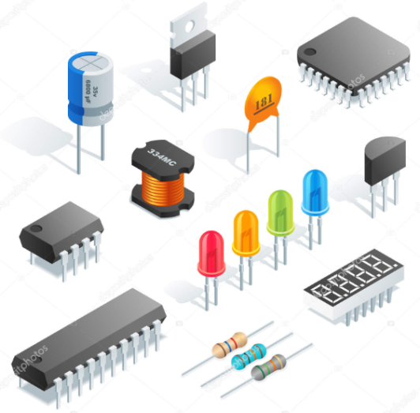
PicoGenius.com
Pico Pi
Electronics

Slide 2
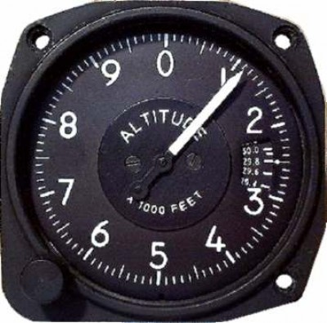
The Altimeter

Slide 3
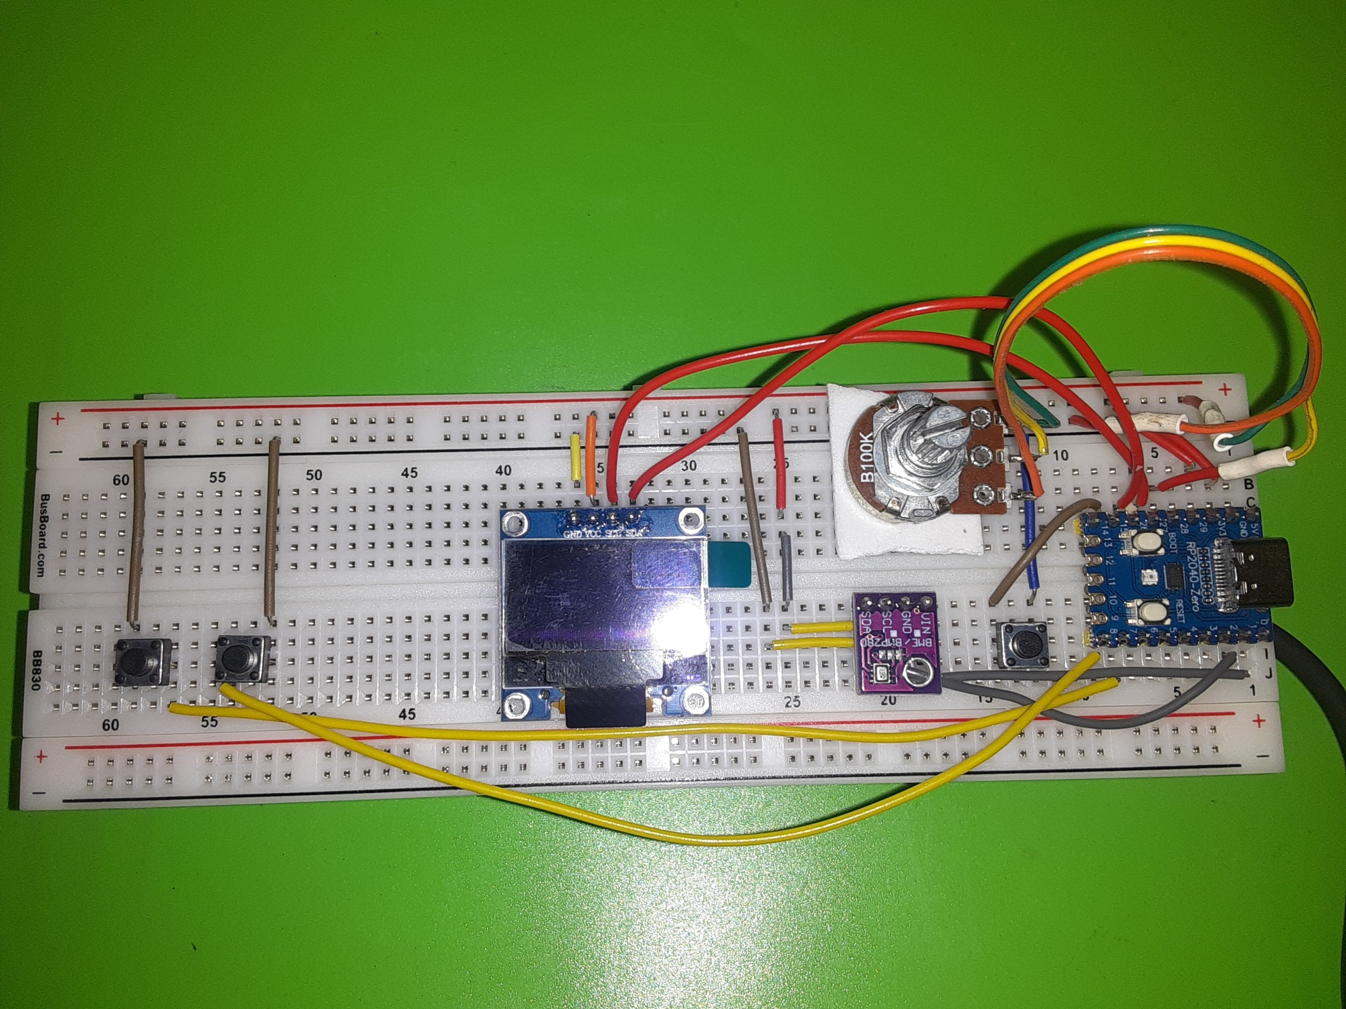
BME 280 Altimeter
Barametric Pressure
Adjustment
OLED Display
Atmospheric Pressure
Sensor (BME 208)
OLED Display
Altitude/Calibrate
Switch
Course
Adjustment
Fine
Adjustment
RP2040 Zero

Slide 4
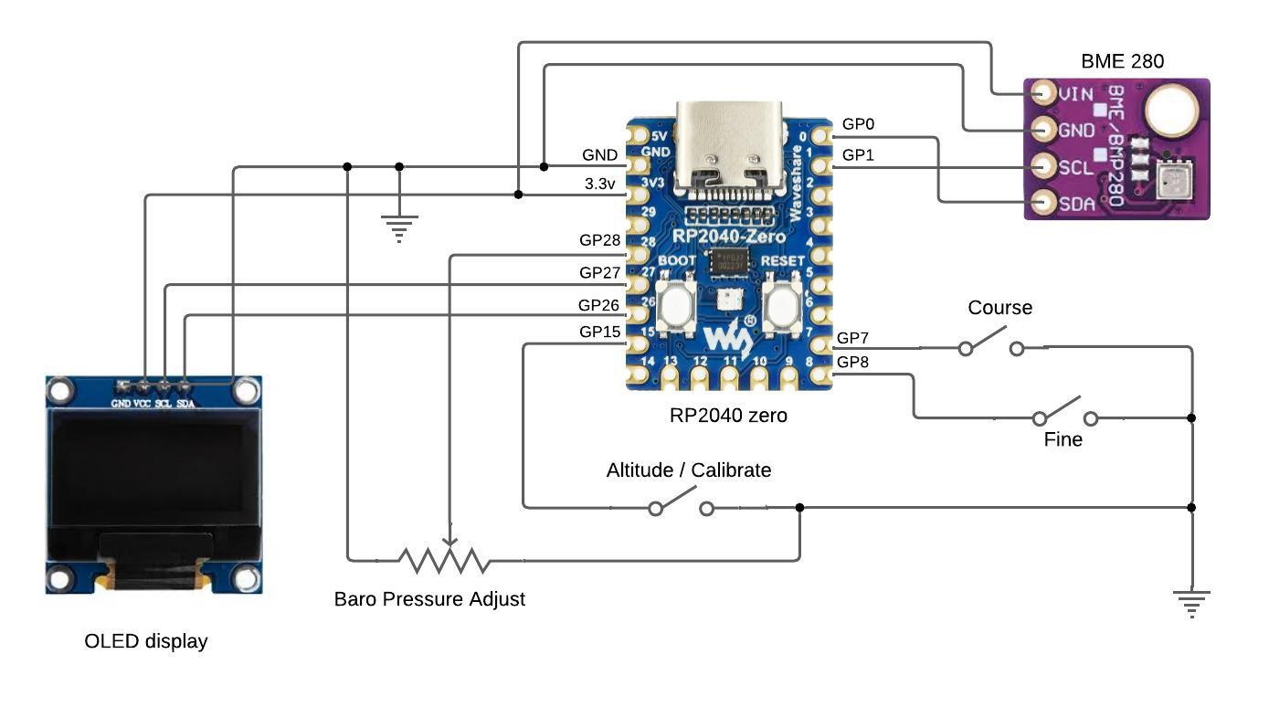

Slide 5
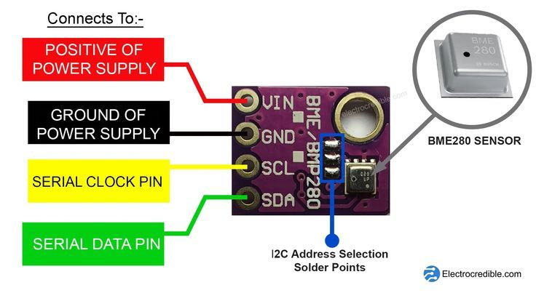

Slide 6
from machine import Pin, I2C, ADC
from time import sleep
import bme280
import framebuf
import utime
import freesans20
import writer
from ssd1306 import SSD1306_I2C
# Initialize I2C for BME280 sensor and OLED display
i2c = I2C(0, sda=Pin(0), scl=Pin(1), freq=400000)
baro = 29.92 # Initial barometric pressure in inHg, adjustable by user
i2c2 = I2C(1, sda=Pin(26), scl=Pin(27), freq=400000)
dsp = SSD1306_I2C(128, 64, i2c2)
dsp.fill(0)
dsp.show()
Notes:
Import all o the necessary libraries.

Slide 7
from machine import Pin, I2C, ADC
from time import sleep
import bme280
import framebuf
import utime
import freesans20
import writer
from ssd1306 import SSD1306_I2C
# Initialize I2C for BME280 sensor and OLED display
i2c = I2C(0, sda=Pin(0), scl=Pin(1), freq=400000)
baro = 29.92 # Initial barometric pressure in inHg, adjustable by user
i2c2 = I2C(1, sda=Pin(26), scl=Pin(27), freq=400000)
dsp = SSD1306_I2C(128, 64, i2c2)
dsp.fill(0)
dsp.show()
Notes:
Initialize the I2C connection for the BME 280 Atmospheric pressure sensor and set the barometric pressure to 29.92. Also initialize the I2C connection for the OLED display and clear the screen.

Slide 8
# Define analog input for variable resistor (assume Pin 28 for ADC input)
analog_in = ADC(Pin(28))
# Define switches for coarse and fine adjustments
coarse_adjust = Pin(7, Pin.IN, Pin.PULL_UP)
fine_adjust = Pin(8, Pin.IN, Pin.PULL_UP)
debounce_time = 200 # debounce time in milliseconds
last_coarse_time = utime.ticks_ms()
last_fine_time = utime.ticks_ms()
mode = "altitude" # Initial mode: 'altitude' or 'pressure_adjust'
last_switch_time = utime.ticks_ms() # Initialize debounce timer for mode switch
switch = Pin(15, Pin.IN, Pin.PULL_UP
Notes:
Define the analog input for the variable resistor on pin 28 of the RP2040. This variable resistor allows the user to set the barometric pressure

Slide 9
# Define analog input for variable resistor (assume Pin 28 for ADC input)
analog_in = ADC(Pin(28))
# Define switches for coarse and fine adjustments
coarse_adjust = Pin(7, Pin.IN, Pin.PULL_UP)
fine adjust = Pin(8, Pin.IN, Pin.PULL_UP)
debounce_time = 200 # debounce time in milliseconds
last_coarse_time = utime.ticks_ms()
last_fine_time = utime.ticks_ms()
mode = "altitude" # Initial mode: 'altitude' or 'pressure_adjust'
last_switch_time = utime.ticks_ms() # Initialize debounce timer for mode switch
switch = Pin(15, Pin.IN, Pin.PULL_UP
Notes:
Define the switches that allow course and fine adjustment of the barometric pressure, and adjust the de-bounce time for the switches.

Slide 10
# Define analog input for variable resistor (assume Pin 28 for ADC input)
analog_in = ADC(Pin(28))
# Define switches for coarse and fine adjustments
coarse_adjust = Pin(7, Pin.IN, Pin.PULL_UP)
fine_adjust = Pin(8, Pin.IN, Pin.PULL_UP)
debounce_time = 200 # debounce time in milliseconds
last_coarse_time = utime.ticks_ms()
last_fine_time = utime.ticks_ms()
mode = "altitude" # Initial mode: 'altitude' or 'pressure_adjust'
last_switch_time = utime.ticks_ms() # Initialize debounce timer for mode switch
switch = Pin(15, Pin.IN, Pin.PULL_UP
Notes:
Define the switch that selects between the altitude and the pressure adjust display modes. Initialize the mode to display altitude and initialize the debounce timer for the mode select switch

Slide 11
# Compensation function for pressure adjustment
def temperature_pressure_compensation(pressure, temperature):
temp_compensation_factor = 1.5
corrected_pressure = pressure + (temp_compensation_factor * (temperature - 25))
return corrected_pressure
# Toggle mode function with debounce
def toggle_mode(pin):
global mode, last_switch_time
current_time = utime.ticks_ms()
if utime.ticks_diff(current_time, last_switch_time) > debounce_time:
mode = "pressure_adjust" if mode == "altitude" else "altitude"
last_switch_time = current_time
# Attach the interrupt to the mode switch
switch.irq(trigger=Pin.IRQ_FALLING, handler=toggle_mode)
Notes:
There are several functions used by the main routine. The pressure sensor on the BME 280 is temperature dependent so the first function compensates the pressure as the temperature varies.

Slide 12
# Compensation function for pressure adjustment
def temperature_pressure_compensation(pressure, temperature):
temp_compensation_factor = 1.5
corrected_pressure = pressure + (temp_compensation_factor * (temperature - 25))
return corrected_pressure
# Toggle mode function with debounce
def toggle_mode(pin):
global mode, last_switch_time
current_time = utime.ticks_ms()
if utime.ticks_diff(current_time, last_switch_time) > debounce_time:
mode = "pressure_adjust" if mode == "altitude" else "altitude"
last_switch_time = current_time
# Attach the interrupt to the mode switch
switch.irq(trigger=Pin.IRQ_FALLING, handler=toggle_mode)
Notes:
The second function handles the switching between the altitude display and pressure adjustment modes, using a debouncing technique to prevent unintended rapid toggling. An interrupt on the toggle switch triggers this function.

Slide 13
# Pressure adjustment based on analog input and switches
def adjust_pressure():
global baro
# Read and scale analog input (assume range maps to 29.50 to 30.50 inHg)
analog_value = analog_in.read_u16()
mapped_pressure = 29.5 + (analog_value / 65535) * 1.0 # Scale to a 1.0 inHg range
# Adjust baro with coarse or fine increments
if not coarse_adjust.value():
baro = mapped_pressure if (utime.ticks_diff(utime.ticks_ms(), last_coarse_time) > debounce_time) else baro
elif not fine_adjust.value():
baro = round(mapped_pressure, 2) if (utime.ticks_diff(utime.ticks_ms(), last_fine_time) > debounce_time) else baro
font_writer = writer.Writer(dsp, freesans20)
Notes:
The adjust_pressure() function reads the analog value from the variable resistor and maps it to a barometric pressure range (e.g., 29.5 to 30.5 inHg).
It then applies either a coarse or fine adjustment based on which switch is pressed, updating the barometric pressure (baro) accordingly. Font_writer = writer.Writer(dsp, freescan20) creates an instance of the Writer class from the writer module. Its purpose is to enable text rendering on the OLED display using the FreeSans20 font.

Slide 14
while True:
bme = bme280.BME280(i2c=i2c)
temp = float(bme.temperature.replace('C', '').strip())
pres = float(bme.pressure.replace('hPa', '').strip())
corrected_pressure = temperature_pressure_compensation(pres, temp)
if mode == "altitude":
altitude = (baro - (corrected_pressure / 33.8638866667)) * 1000
alt = int(altitude)
# Display altitude on OLED
dsp.fill(0)
font_writer.set_textpos(5, 30)
font_writer.printstring(f"{alt}")
font_writer.set_textpos(60, 30)
font_writer.printstring("FT")
dsp.show()
Notes:
Each iteration of the loop starts by reading the temperature and pressure from the BME280 sensor. The raw pressure is compensated for temperature using the temperature_pressure_compensation() function.

Slide 15
while True:
bme = bme280.BME280(i2c=i2c)
temp = float(bme.temperature.replace('C', '').strip())
pres = float(bme.pressure.replace('hPa', '').strip())
corrected_pressure = temperature_pressure_compensation(pres, temp)
if mode == "altitude":
altitude = (baro - (corrected_pressure / 33.8638866667)) * 1000
alt = int(altitude)
# Display altitude on OLED
dsp.fill(0)
font_writer.set_textpos(5, 30)
font_writer.printstring(f"{alt}")
font_writer.set_textpos(60, 30)
font_writer.printstring("FT")
dsp.show()
Notes:
If the program is in the altitude mode, it calculates the altitude from the current barometric pressure and the compensated pressure reading, converting it to feet.
It then displays the calculated altitude on the OLED, refreshing every second.

Slide 16
elif mode == "pressure_adjust":
adjust_pressure()
# Display current barometric pressure for adjustment
dsp.fill(0)
font_writer.set_textpos(5, 20)
font_writer.printstring("Set Pressure:")
font_writer.set_textpos(20, 40)
font_writer.printstring(f"{baro:.2f} inHg")
dsp.show()
sleep(1)
Notes:
If the program is in the pressure adjustment mode, The adjust_pressure() function is called to adjust the baro variable based on the analog input and the switches.
The OLED shows the current barometric pressure value, allowing the user to view changes in real-time as they adjust the variable resistor or press the adjustment switches.
The loop ends with a sleep(1) delay to limit the display refresh rate to once per second,

